Slide 2
Introduction
Tina Grosowsky
Program Coordinator, Central MA Tobacco Free Community Partnership
Prevent youth from starting to use tobacco/nicotine
Help people quit using tobacco/nicotine
Protect everyone from secondhand smoke
Funded by the Massachusetts Tobacco Cessation and Prevention program, a Community Partnership in your region can provide free resources to your community.

Slide 3
Agenda
Why we are here
Vaping 101
Tobacco & Vaping Industry Tactics
Vaping policies and procedures
What you can do
Questions/Discussion

Slide 5
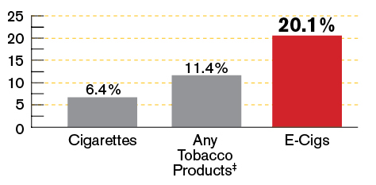
Youth use of vaping products
In 2017 41.1% of MA high school youth had ever used
e-cigarettes.
High school youth current
use of e-cigarettes was higher than use of any other tobacco products combined
Current† Use of Tobacco and Vaping
Products by MA High School Youth, 2017
† Use in the past 30 days
‡ Any tobacco defined as cigarettes, cigars (including little cigars and cigarillos), and smokeless tobacco (chewing tobacco, snuff, dip)
Notes:
Source: 2017 MA YRBS
Young people are using these products more than any other tobacco product (read slide aloud)
2017 adult data is not yet available, but in 2015, e-cigarette use among high school youth was 9 times higher than that of adults.

Slide 6
CDC data
Among high school students, e-cigarette use surged nearly 78 percent. In 2018, nearly 21 percent of high school students vaped, up from close to 12 percent in 2017.
In 2018, 1.5 million more middle school and high school students vaped than in 2017, up to 3.6 million from 2.1 million, according to the survey.

Slide 7
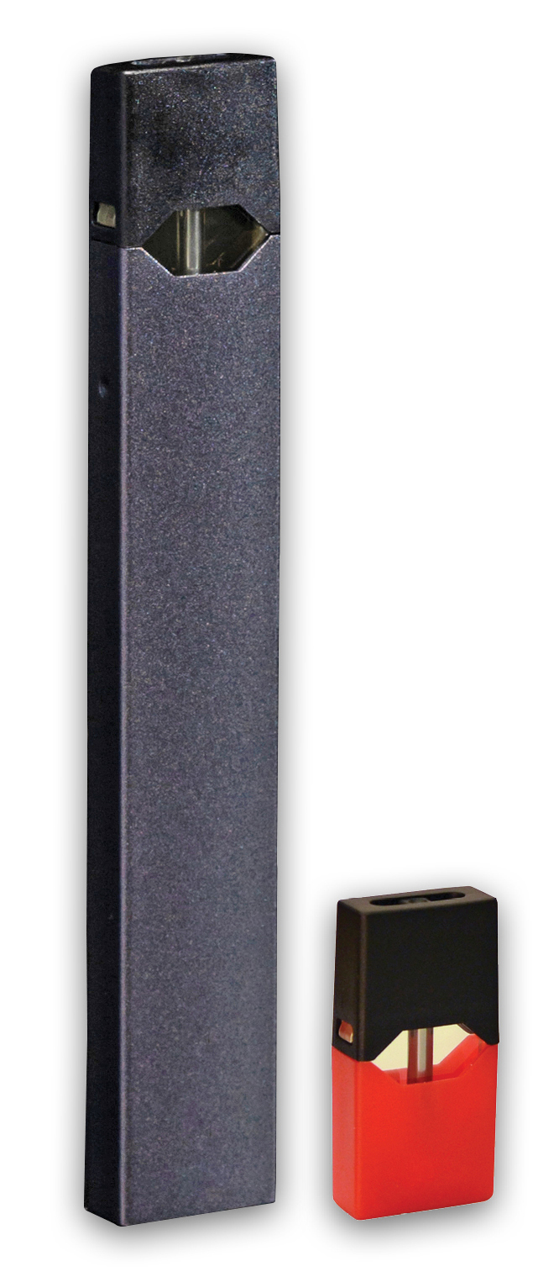
Vaping 101
What do they look like? Is it just water vapor?

Slide 8
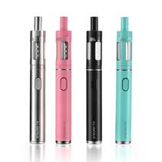
What is vaping?
Inhaling/exhaling the aerosol (often called vapor) produced by an e-cigarette or similar battery-powered device
Called e-cigs, vape pens, e-hookahs, e-pipes, tanks, mods, vapes, electronic nicotine delivery systems, or ENDS, and more
Sometimes referred to by brand names such as JUUL (JUULing), BO, Blu, and others
Notes:
Talking Points:
What is vaping? Vaping is the act of inhaling and exhaling the aerosol (often called vapor) produced by an e-cigarette or similar battery-powered device.
What is an e-cigarette? E-cigarettes are battery-powered vaporizers that simulate the action and sensation of smoking.
What are other names for e-cigarettes? They are also known as e-cigs, vape pens, e-hookahs, e-pipes, tanks, mods, vapes, electronic nicotine delivery systems, or ENDS, and more. Some people refer to vaping devices by their brand name such as JUUL, BO, Blu, and others.

Slide 9
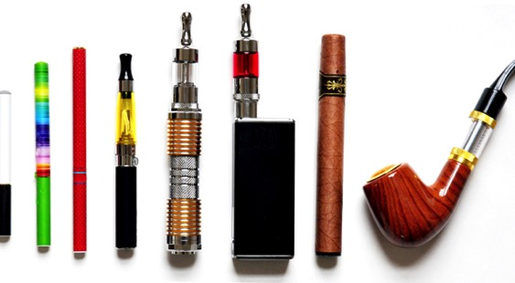
The New Look of Nicotine Addiction
Notes:
Talking Points:
E-cigarettes come in many different sizes, types, and colors.
Some e-cigarettes are made to look like regular cigarettes, cigars, or pipes. Some resemble pens, small electronic devices such as USB sticks, and other everyday items. The products that are designed to resemble small electronic devices are often compact and allow for discreet carrying and use—at home, in school hallways and bathrooms, and even in classrooms.

Slide 10
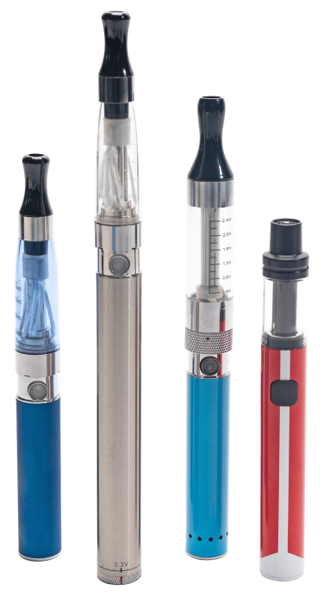
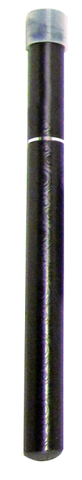
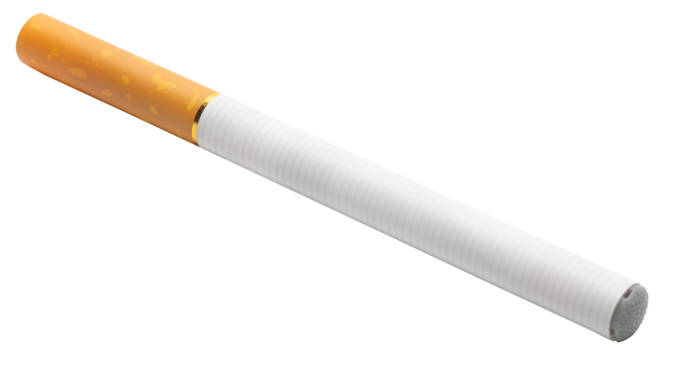
Types of products
Disposable E-cigarettes
Vape Pens
Notes:
Talking Points:
Disposable e-cigarettes often appear like actual, filter cigarettes in both shape and coloring. Common brand names include Zig Zag, Vapor4Life, V2, and White Cloud.
Medium-sized tank vaping devices are commonly referred to as vape pens. They are generally more compact than other vape devices and are relatively easy to conceal. Pens have often been used discreetly by youth at school and home. Common pen brands include JUUL, Aspire, Apollo, and Kanger among others.

Slide 11
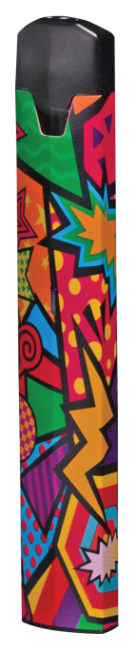
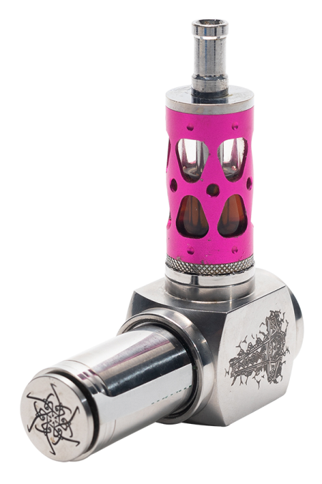

Tank Systems
Rechargeable E-cigarettes
(Bo & JUUL)
Notes:
Talking Points:
Tank systems come in medium- to large-size devices that bear little or no resemblance to other tobacco products. They come in disposable and “rebuildable” versions, under brand names such as Aspire, Smok, Vaporesso, and Kangertech
Rechargeable e-cigarettes often look like small electronic devices such as a USB stick. Common brand names are JUUL, Bo, and myblu. They frequently are sold with pre-filled cartridges or pods.
It is helpful to note that many types of e-cigarettes are rechargeable, except for disposable e-cigarettes which are disposed of after the initial charge of the battery is depleted.

Slide 12
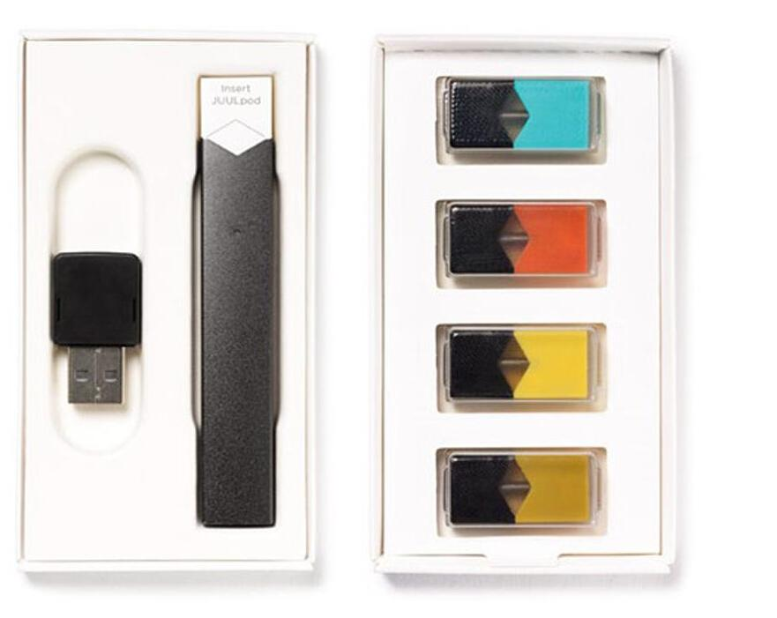

JUUL (JUULing)
Notes:
Nicotine salt-
Seen as safe- major misconception about harms of e-cigarettes among general public.
Also a slightly risky and cool trend among youth
Nicotine buzz & head rush. There’s a reason people enjoy using nicotine products
Continued use because they are addicted
Flavors - tobacco & vaping industry targeting kids.

Slide 13
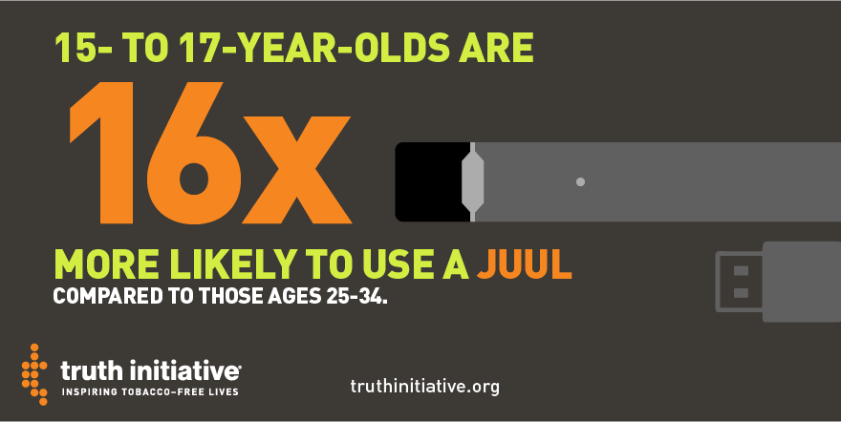
Truth Initiative facts:

Slide 14
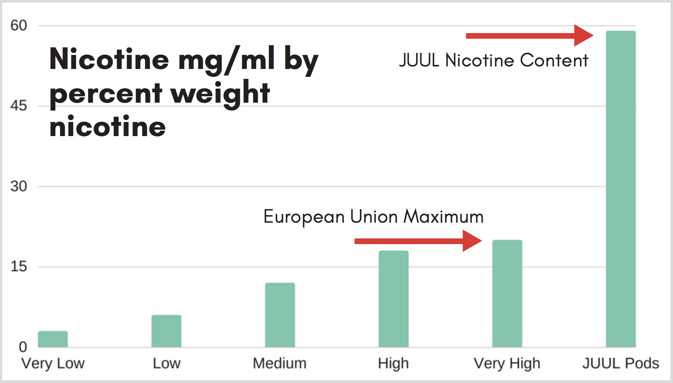
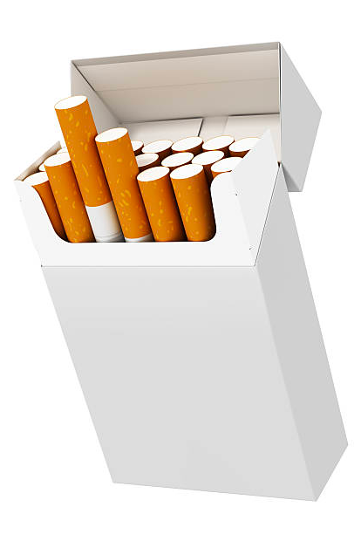
Nicotine content in juul
=
1 JUUL
Pod
1 Pack of Cigarettes
Notes:
From CATCH
JUUL Pods have an incredibly high nicotine concentration, which puts each puff from a JUUL on par with the nicotine delivered in a puff from a traditional cigarette. This is not the norm for e-cigarettes. In fact, JUULs are more than double the maximum concentration allowed in the European Union, and the sale of JUUL devices was recently banned in Israel because of their remarkably high nicotine content.
The amount of nicotine in a single JUUL Pod is equal to the amount of nicotine found in an entire pack of cigarettes and includes roughly the same number of “puffs” (200).

Slide 15


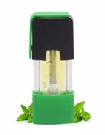
E-liquids and E-Juices
Pods
Notes:
Talking Points:
As we talked about under the tactic of “sweet,” E-cigarettes and other vaping devices are considered either open or closed systems. In open systems, the user adds the e-liquid (commonly referred to as e-juice). In closed systems, the user uses pre-filled cartridges or pods. The vaping devices convert the e-liquids into an inhalable aerosol.
E-liquids/juices come in thousands of flavors including chocolate, cotton candy, fruit punch, gummi bear, banana, peach, lime, and many others. Flavors are often cited as the main reason youth try these products.

Slide 16
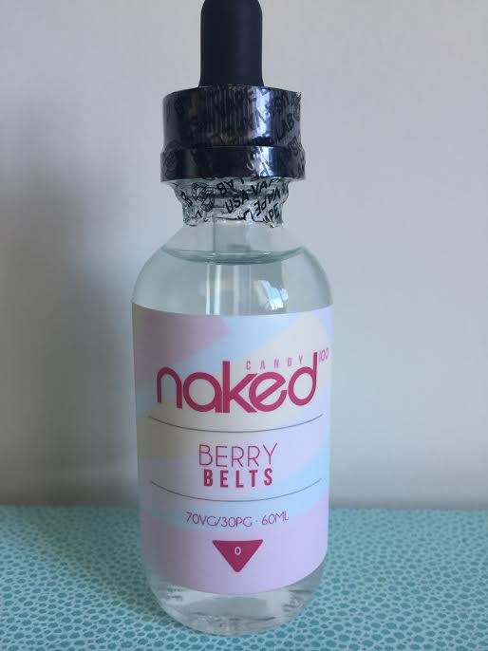
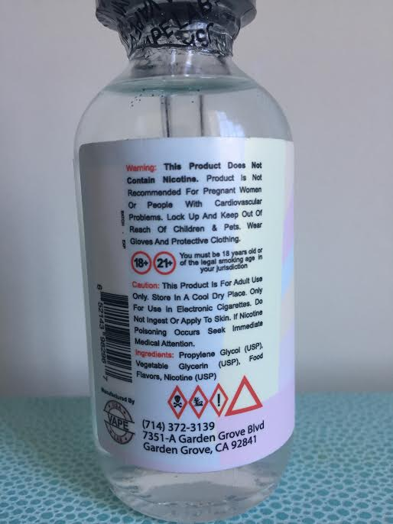

Slide 17


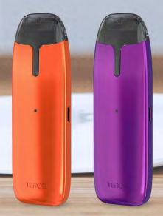




New and emerging products
Notes:
Talking Points:
Tobacco and vaping companies appear to be introducing many new types of e-cigarettes that are sleek, concealable, and modern.
Some vendors state that they can’t keep up with the volume of new e-cigarette products.
Major tobacco companies and independent companies are producing these types of e-cigarettes.
Many of the new e-cigarettes closely resemble the design features of JUUL. In addition to the JUUL style that look like a USB stick, new concealable e-cigarettes have been introduced in additional shapes.
Companies are also now introducing pre-charged, completely disposable e-cigarettes. (From Campaign for Tobacco-Free Kids)

Slide 18
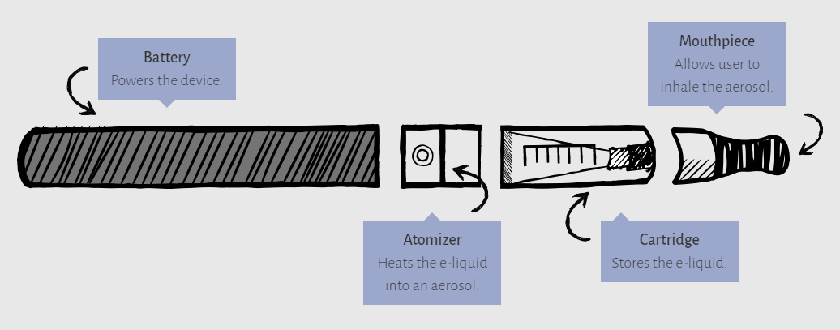
How it works
Notes:
Talking Points:
E-cigarettes create an aerosol by using a battery to heat up liquid that usually contains nicotine, flavorings, and other additives. Users inhale this aerosol into their lungs. E-cigarettes can also be used to deliver cannabinoids such as marijuana, and other drugs.
Image and language pulled from: https://e-cigarettes.surgeongeneral.gov/getthefacts.html

Slide 19
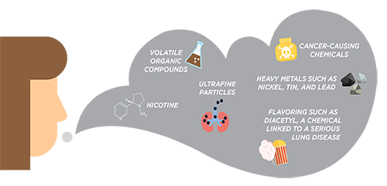
Vapor vs. Aerosol
Produces an aerosol, NOT water vapor
Aerosol can contain harmful substances:
https://www.cdc.gov/tobacco/basic_information/e-cigarettes/index.htm
Notes:
E-cigarettes contain pre-filled pods or e-liquids/e-juices the user adds to the device. E-liquids generally consist of propylene glycol, glycerin, water, nicotine, and flavorings. Many of these pods and e-liquids come in fruit and candy flavors that appeal to youth.
E-cigarettes produce an aerosol, commonly called vapor, which users inhale from the device and exhale. The aerosol can contain harmful and potentially harmful substances, including:
Nicotine
Ultrafine particles that can be inhaled deep into the lungs
Flavoring such as diacetyl, a chemical linked to a serious lung disease
Volatile organic compounds
Cancer-causing chemicals
Heavy metals such as nickel, tin, and lead
E-Cigarettes are so new that we do not have long-term research of health effects of heating and inhaling these chemicals and metals.
We have some research about what happens when you inhale the food flavoring diacetyl – it is associated with causing popcorn lung- a scarring of the lungs- which causes coughing, wheezing, shortness of breath and causes irreversible lung damage.
What we have long-term research on is nicotine- which is specifically harmful for the adolescent brain and highly addictive.

Slide 20
Nicotine
Vaping devices and e-cigarettes contain nicotine—a highly addictive substance
We can’t be sure what is in these products or how much nicotine they contain
Notes:
Talking Points:
Vaping devices and e-cigarettes contain nicotine. Nicotine is highly addictive.
The Food and Drug Administration’s (FDA) Center for Tobacco Products has the authority to regulate the manufacture, import, packaging, labeling, advertising, promotion, sale, and distribution of electronic nicotine delivery systems. The FDA does not have authority to regulate vaping accessories.
The FDA has delayed using its regulatory authority over other areas of e-cigarettes, including the manufacture of e-liquids until 2022. Without manufacturing regulations, people can’t be sure what is in these products.

Slide 21
Adolescents are especially harmed by nicotine
Nicotine affects a young person’s developing brain. Brain development continues through the mid-20s.
Effects of youth nicotine exposure include:
  lower impulse control
  depression or mood disorders
  disruption of brain circuits that control learning
  can prime young brains for future drug addiction
Notes:
Emphasize that it is important to prevent youth from using tobacco as they are especially harmed by nicotine.
Nicotine can produce structural and chemical changes to the developing brain that interferes with normal development and can make young people vulnerable to future alcohol, tobacco, and other drug addiction and to mental illness.
Be prepared to mention resource on this subject for those who want to know more. There are many studies out there, but these comments are taken from an interview with Nora Volkow, M.D., Director of the National Institute of Drugs at http://thechallenge.org/14_3_interview.html/
1. U.S. Department of Health and Human Services. E-Cigarette Use Among Youth and Young Adults: A Report of the Surgeon General—Executive Summary. Atlanta, GA: U.S. Department of Health and Human Services, Centers for Disease Control and Prevention, National Center for Chronic Disease Prevention and Health Promotion, Office on Smoking and Health, 2016.

Slide 22

Nicotine
Youth who use e-cigarettes are more likely to become traditional cigarette smokers¹
People who start smoking or using tobacco products in adolescence, smoke more and have a harder time quitting than people who start as adults²
Notes:
According to the Centers for Disease Control and Prevention (CDC), e-cigarettes are not safe for youth, young adults, pregnant women, or adults who do not currently use tobacco products.
According to the Surgeon General, because the brain isn't fully developed until the mid 20s, youth and young adults are uniquely at risk for long-term, long-lasting effects of exposing their developing brains to nicotine.
Risks include: nicotine addiction, mood disorders, and permanent lowering of impulse control. Nicotine also changes the way synapses are formed, which can harm the parts of the brain that control attention and learning.
Nicotine can also prime the adolescent brain for addiction to other substances.
E-cigarette use among youth and young adults is strongly linked to the use of other tobacco products such as regular cigarettes, cigars, hookah, and smokeless tobacco.
Due to changes in the brain, quitting is harder for those who start at a young age. Prevention is key.
References:
1. Surgeon General’s Know the Risks: https://e-cigarettes.surgeongeneral.gov/knowtherisks.html
2. Many published studies have shown this, including: Abreu-Villaca, Y. et al (2003). Short-term adolescent nicotine exposure has immediate and persistent effects on cholinergic systems: Critical periods, patterns of exposure, dose thresholds. Neuropsychopharmocology, 28 pp. 1935-1949

Slide 23
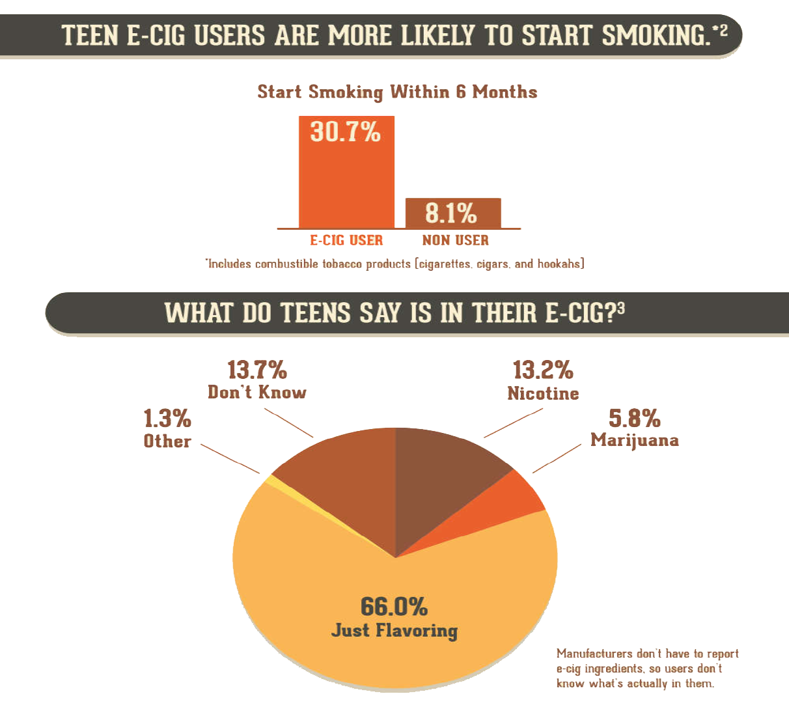
Notes:
***From CATCH
These graphics from the National Institutes of Health illustrate some of the points we discussed in the previous slide. The top chart shows E-cigarette use among teens as a predictor of future use of traditional tobacco products, including cigarettes, cigars, and hookahs. 30.7 percent of teen E-Cigarette users started smoking within 6 months while 8.1 percent of non-users started smoking.
The second figure shows the knowledge gap that students have about e-juice ingredients. What we see is not just that 13.7% of teens “Don’t Know” what’s in their E-Cigarette, 66% believe it is just flavoring. As we learned earlier, there are many different chemicals in E-Cigarette vapor, and more often than not there is nicotine. According to the Truth Initiative, 99% of E-Cigarettes sold in 2015 contained nicotine. Manufacturers don’t have to label or report the ingredients, so users don’t know what’s actually in them.
Source: National Institute on Drug Abuse; National Institutes of Health; U.S. Department of Health and Human Services
https://www.drugabuse.gov/related-topics/trends-statistics/infographics/teens-e-cigarettes

Slide 24
Are e-cigarettes safe?
E-cigarettes are not safe for youth, young adults, pregnant women, or adults who do not currently use tobacco products (CDC)
  Contains nicotine and other chemicals
More research is needed to understand the long-term health effects
Secondhand vape is also unsafe
Notes:
According to the Centers for Disease Control and Prevention, e-cigarettes are not safe for youth, young adults, pregnant women, or adults who do not currently use tobacco products.
Additional research is needed to help understand long-term health effects of e-cigarette use.
E-cigarettes contain nicotine. Nicotine is a highly addictive substance.
According the Surgeon General, the aerosol from e-cigarettes is not harmless. It can contain harmful and potentially harmful chemicals, including nicotine; ultrafine particles that can be inhaled deep into the lungs; flavoring such diacetyl, a chemical linked to a serious lung disease; volatile organic compounds such as benzene, which is found in car exhaust; and heavy metals, such as nickel, tin, and lead.
OTHER HARMS
Due to nicotine content, e-liquids are dangerous to small children and pets. The Massachusetts Attorney General requires that nicotine liquid and gel be sold in appropriate child-resistant packaging.
Defective e-cigarette batteries have caused fires and explosions, some of which have resulted in serious injuries.

Slide 25
Can e-cigarettes be used to vape other substances?
Yes!
Open systems require the user to add the e-juice, which can be a substance other than nicotine (including marijuana and other illicit drugs).
Closed systems (those that use pre-filled pods) can also be altered to vape substances other than nicotine.
Notes:
Talking Points:
Many people specifically ask if e-cigarettes can be used to vape marijuana. The answer is yes.
Marijuana can be vaped in open systems, that require the user to add the e-juice
Closed systems (those that use pre-filled pods) can also be altered to vape substances other than nicotine.

Slide 26
How do we know if our students are vaping?
Unexplained Sweet Scent – might be a flavored e-juice for a vaping device
Unfamiliar Products – If you come across unusual pens or USB drives or an unfamiliar battery or battery charging device, they could be associated with vaping
Notes:
You might also observe signs of nicotine addiction, which could include leaving the class frequently (students feeling a need to use nicotine) and symptoms of withdrawal when they have gone long periods without vaping such anxiety, irritability, restlessness, difficulty concentrating, depressed mood, frustration, and anger (source: Mayo Clinic))

Slide 27
Tobacco and Vaping Industries
The industries target youth with sweet,
cheap, and easy to get products.

Slide 28
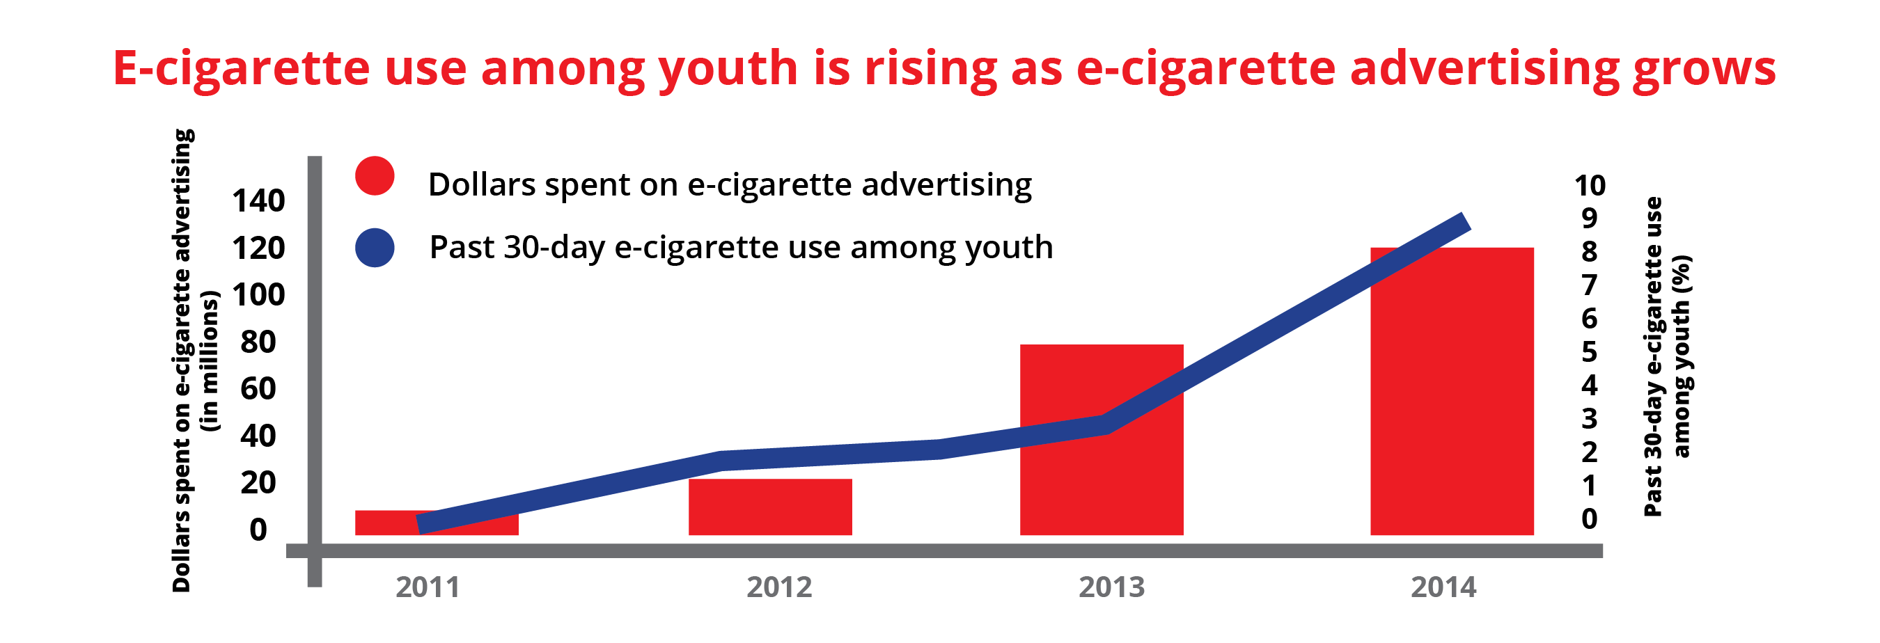
Tobacco & Vaping Industries Tactics
Source: National Youth Tobacco Survey, 2011-2014; Kim et al (2014), Truth Initiative (2015)
Notes:
The tobacco and vaping industries spends millions of dollars targeting youth.
They want to get youth hooked to make them lifelong customers.
In this graph you can see how as e-cigarette advertising increases, so does youth use!

Slide 29
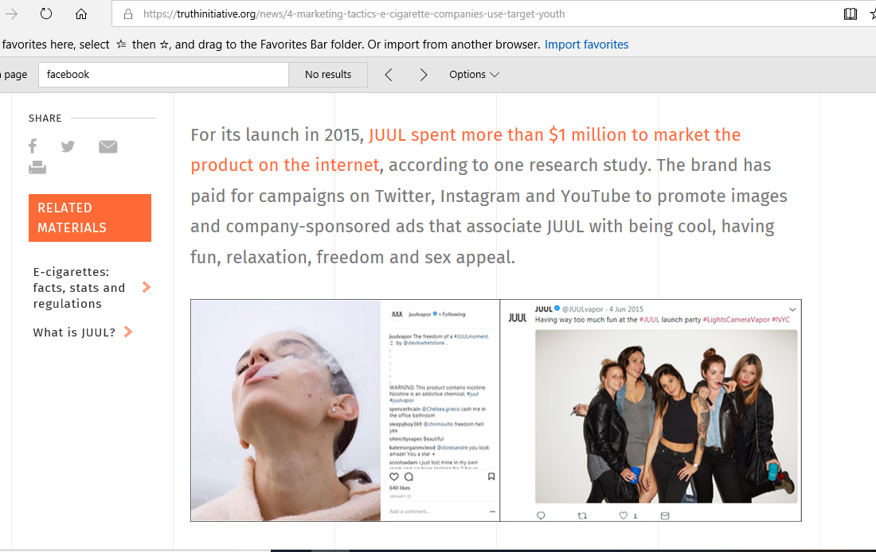
https://truthinitiative.org/news/4-marketing-tactics-e-cigarette-companies-use-target-youth

Slide 30

https://www.tobaccofreekids.org/assets/factsheets/0394.pdf
JUUL billboard in Times Square, New York City, 2015. https://www.spencer-pederson.com/work1/2017/2/23/juul-go-to-market

Slide 31
Industry tactics
The tobacco and vaping industries target young people by making their products:
  Sweet
  Cheap
  Easy to Get
Notes:
The tobacco industry has a history of targeting groups of people to make them new customers. This is nothing new – the tobacco and vaping industries are using the same tactics with these new and emerging products.
The tobacco and vaping industry know that people are most susceptible to nicotine addiction in their teens. There are public documents from the tobacco industry saying this.
E-Cigarettes and flavored tobacco products are undermining the nations efforts to reduce youth tobacco use- and they’re putting a new generation of kids at risk of nicotine addiction and negative health effects.
They’re targeting kids with products that are sweet, cheap, and easy to get.

Slide 32
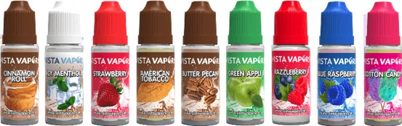
Sweet
E-liquids and juices contain flavorings
Thousands of sweet and fruity flavors to pick from (chocolate, cotton candy, fruit punch, mango…)
Flavors appeal to youth
Flavors may make vaping seem harmless
Notes:
The first tactic is sweet.
According to the FDA (Food and Drug Administration), flavored tobacco products appeal to youth. Tobacco industry documents show that companies designed flavored cigarettes with kids in mind. That’s why the FDA made it illegal to sell flavored cigarettes (except for menthol) in 2009. But that action excluded other tobacco products such as cigars, chewing tobacco or other emerging products such as e-cigarettes.
E-cigarettes contain pre-filled pods or e-liquids/e-juices the user adds to the device. E-liquids generally consist of propylene glycol, glycerin, water, nicotine, and flavorings. Many of these pods and e-liquids come in fruit and candy flavors that appeal to youth.
E-liquids come in flavors such as chocolate, cotton candy, fruit punch, etc.
There are thousands of flavors to pick from.
Some cities and towns across Massachusetts have local policies in place to restrict the sale of flavored tobacco products to adult-only retail establishments such as tobacconists or vape shops. This policy removes flavored products from corner stores, convenience stores, gas stations, bodegas, and other places youth frequent. (Note: Does your city/town have this restriction in place? To find out, contact your local board of health.)

Slide 33
Sweet – Menthol/Mint/Wintergreen
In 2009, the FDA banned flavored cigarettes, but excluded menthol/mint/wintergreen​
​
Nearly 70% of MA youth said that they see mint/menthol tobacco products used, sold, or advertised in their community​
​
Youth of color in MA are two times more likely to say that the tobacco industry intentionally targets menthol toward youth of color compared to white youth

Slide 34
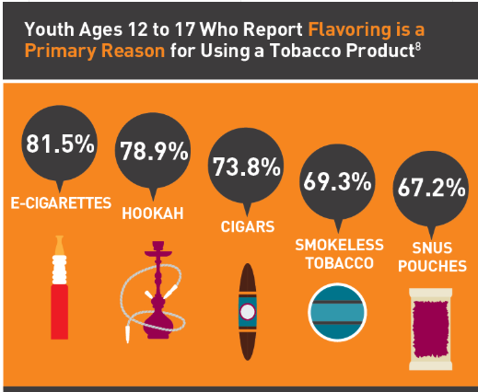
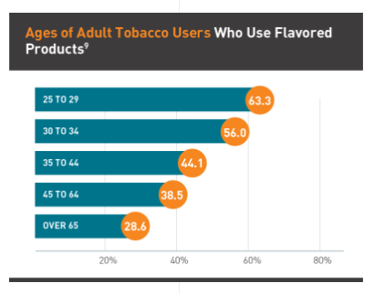
Sweet – Do flavors appeal to adults?
Younger people are more likely to use flavored products than adults
Source: Truth Initiative, truthinitiative.org/news/flavored-tobacco-use-among-youth-and-young-adults
Notes:
In the U.S., more than four out of five young adults ages 18 to 24 who have ever used tobacco reported that their first product was flavored.
Flavored tobacco product use is higher in younger adults than in older adults. Nearly three-quarters of young adult current tobacco users report flavored tobacco use, compared to just 28.6 percent of adults over 65.
National data found on: https://truthinitiative.org/news/flavored-tobacco-use-among-youth-and-young-adults

Slide 35
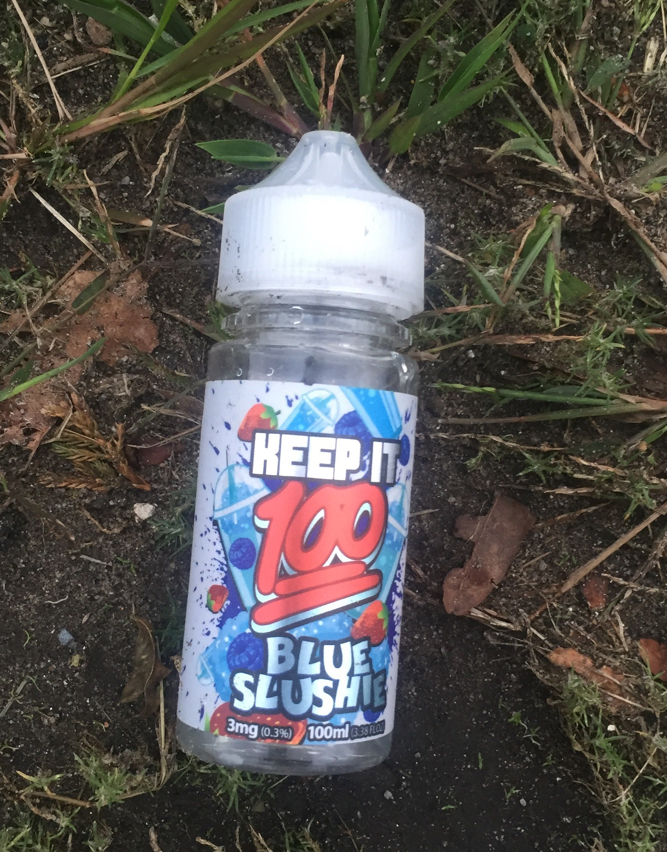

Slide 36
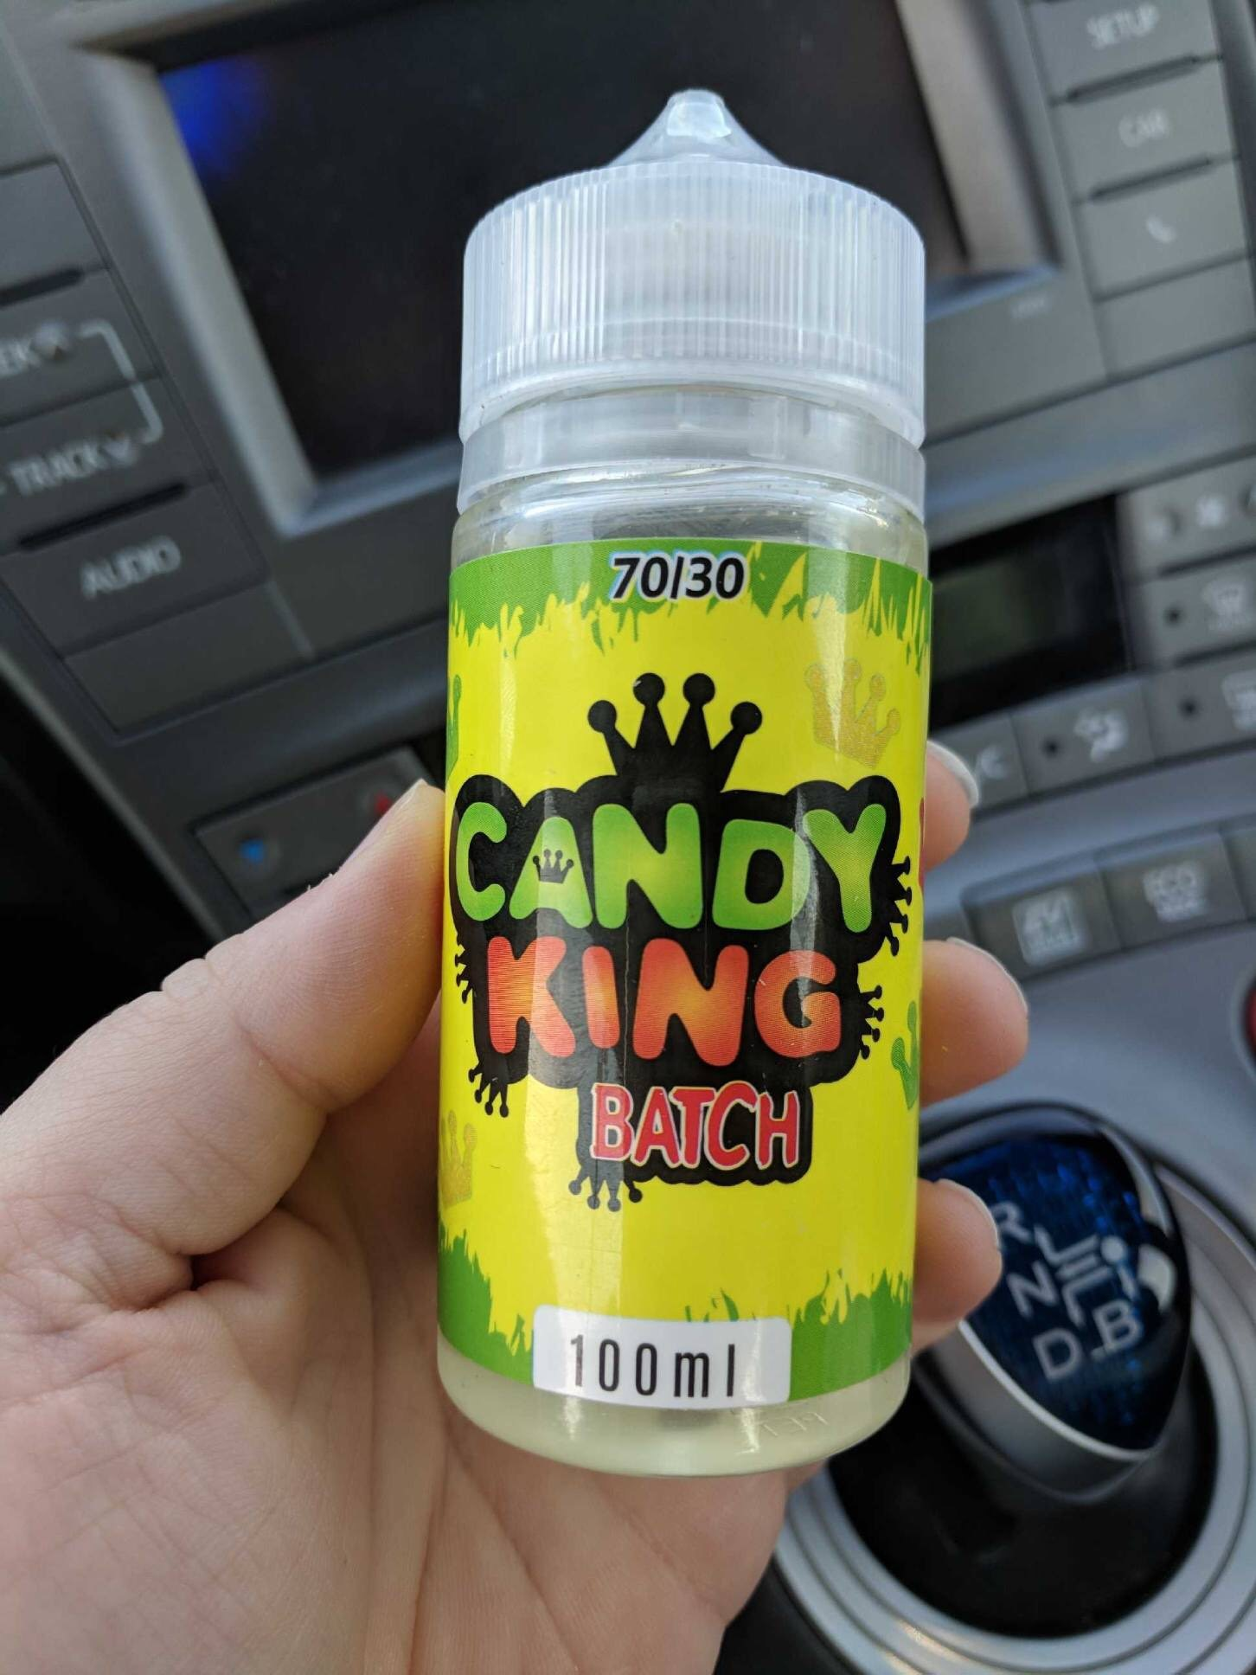
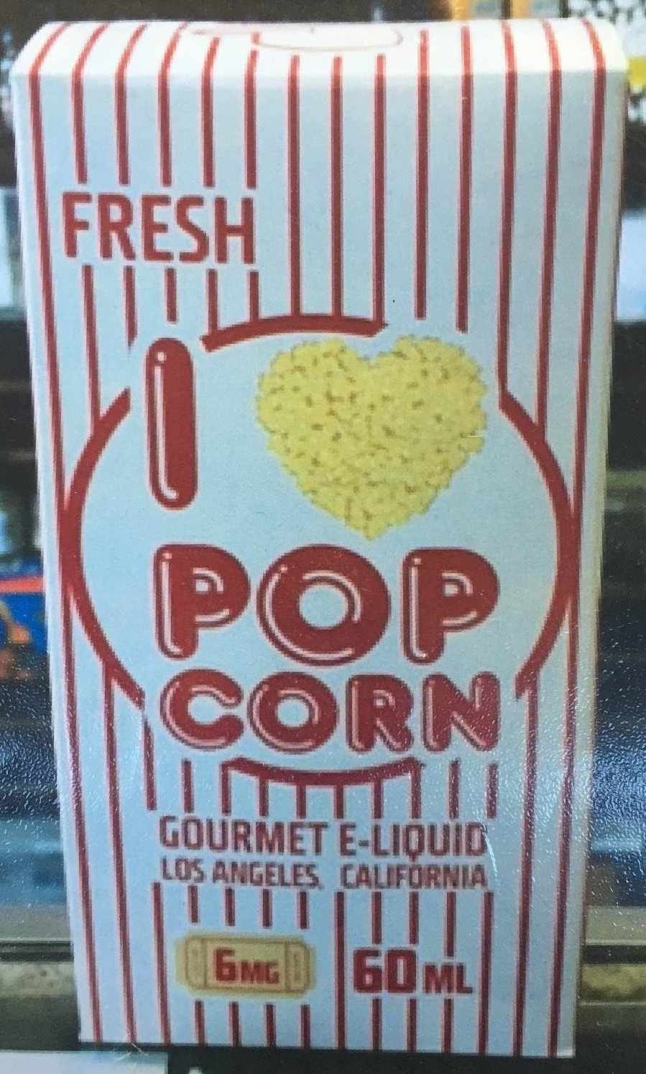

Slide 37

Cheap
Products are often inexpensive—special offers and coupon codes make them cheap
Low prices create
impulse buys
Notes:
The industries use low prices, coupons, and sales or specials to make their products cheap.
Sometimes the starter kits seem costly at first, but the pods that deliver nicotine are competitively priced with other tobacco products.
Youth are more likely to buy when the price is low, and less likely to buy when it is high. This is why youth cigarette smoking has dropped in the past when there have been tax increases.*
*Chaloupka, F., “Macro-Social Influences: The Effects of Prices and Tobacco Control Policies on the Demand for Tobacco Products," Nicotine and Tobacco Research, 1999; and others.
Other tobacco products such as flavored cigars can often be found at inexpensive prices.
Anecdotally, we hear that youth may share a device or pods/e-juices to cut down on the cost.
Some cities and towns across Massachusetts have local policies in place to restrict the sale of cheap, single cigars. The policy sets a minimum price and package size for cigars. (Note: Does your city/town have this policy in place? To find out, contact your local board of health.)

Slide 38
Price increases are effective
High price is the most effective way to reduce youth tobacco use.
Each 10% increase in price leads to a 7% reduction in youth smoking.³
Youth cigarette smoking rate at an historic low—6.4% in 2017.
Notes:
The 2012 Surgeon General’s report, Preventing Tobacco Use Among Youth and Young Adults, stated, “Federal, state, and local taxes that raise prices on tobacco products improve public health by reducing initiation, prevalence, and intensity of smoking among young people. Comprehensive reviews of the literature on the effect of price on tobacco consumption estimate a 3–5% reduction in overall cigarettes consumed as a result of a 10% increase in cigarette prices, and youth and young adults have proven to be even more responsive than adults to higher cigarette prices.”
Source: HHS, Preventing Tobacco Use Among Youth and Young Adults: A Report of the Surgeon General, 2012,
http://www.surgeongeneral.gov/library/reports/preventing-youth-tobacco-use/full-report.pdf

Slide 39
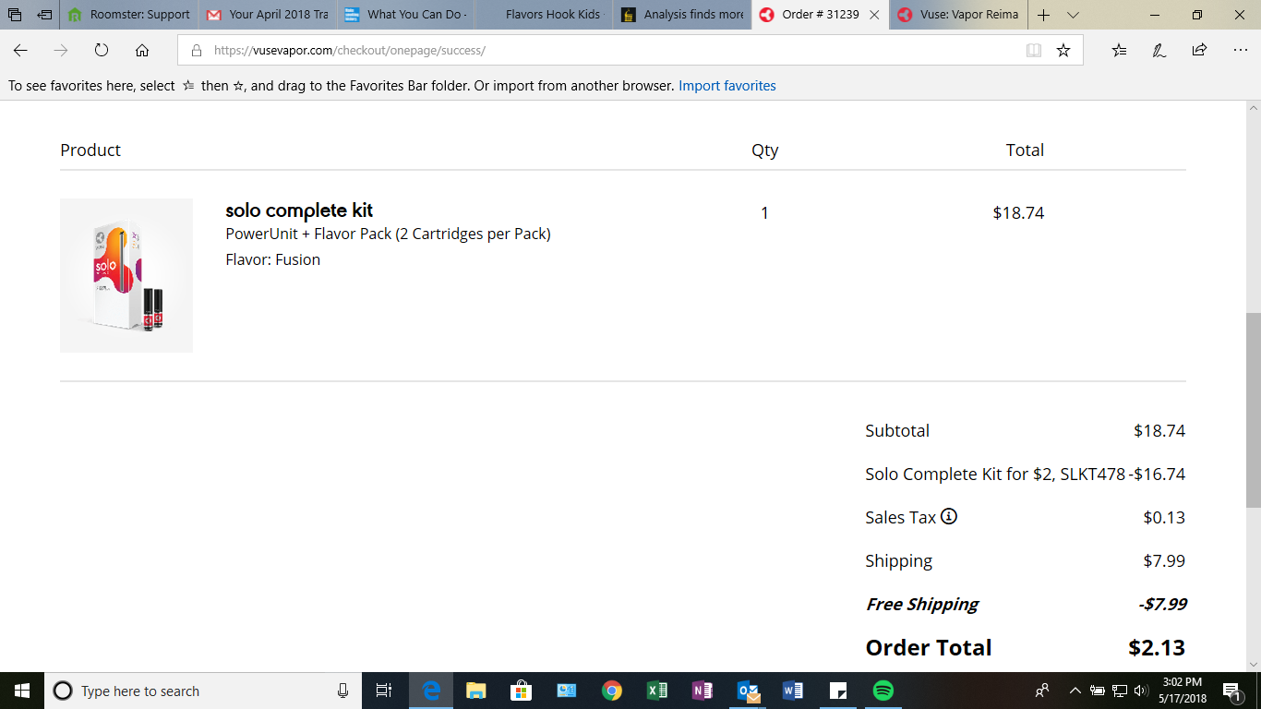
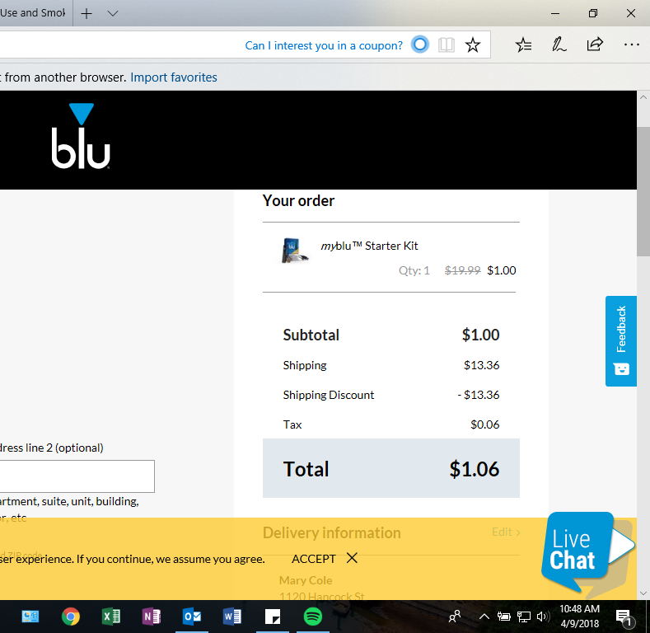

Slide 40
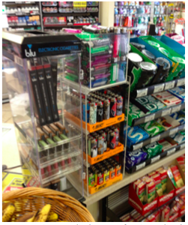
Easy to get
Vaping products are everywhere—corner stores, gas stations, vape shops, online
Availability sends the message that these products are normal and fine
The more youth see them, the more likely they are to buy and use
Notes:
Talking Points:
E-cigarettes are sold in many places including convenience stores, corner stores, gas stations, vape shops, and online. These flavored products are often found on counter tops, or next to candy displays, where they are visible and easily accessible to youth.
Just like other tobacco and nicotine products, youth may get e-cigarettes from many sources. Youth who use these devices may not purchase them directly from a retailer; they may have access to e-cigarettes through friends who vape or from online stores that accept gift cards, for example.
This availability sends the message that these products are normal and fine – and availability leads to impulse buys.
The more you see them, the more likely you are to buy them.
Research shows that kids who shop at stores with tobacco two or more times a week are 64% more likely to start smoking than their peers who don’t.*
(*Henriksen, Schleicher, Feighery and Fortmann. A Longitudinal Study of Exposure to Retail Cigarette Advertising and Smoking Initiation. Pediatrics: The Official Journal of the American Academy of Pediatrics. July 19, 2010, DOI: 10.1542/peds.2009 3021)
Governor Baker recently signed legislation that prohibits the sale of tobacco products by any pharmacy, hospital, or other entity that offers health care services or that employs any licensed health care providers – as of December 31, 2018 tobacco will no longer be sold in the corner pharmacy.

Slide 41

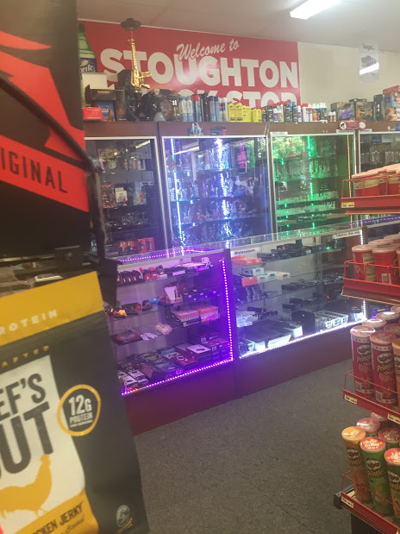
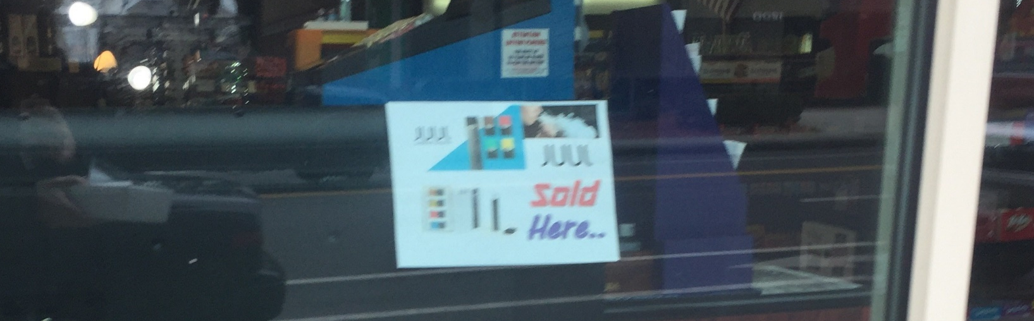

Slide 42
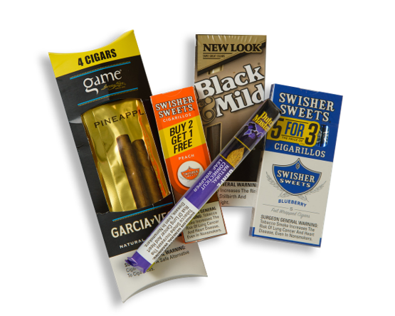
Cheap
As of March 2019, ​
173 municipalities in MA have passed policies that restrict the sale of cheap, single cigars.

Slide 43
Easy to Get
As of March 2019 125 municipalities have capped the number of tobacco retail licenses​
​
As of March 2019 102 municipalities have prohibited issuing new tobacco permits within 500 feet of a school

Slide 44
Vaping POLICIES AND PROCEDURES
Notes:
Talking Points:
What are the policies and procedures our school/organization has in place to address vaping?

Slide 45
State Laws
7/27/2018 Governor Baker signed H4486, An Act protecting youth from the health risks of tobacco and nicotine addiction
  Raises the legal age to buy tobacco products statewide from 18 to 21.
  The new law broadens existing prohibitions on public smoking to include e-cigarettes and prohibits the use of tobacco products on the grounds of any public or private primary, secondary, or vocational school.
  Pharmacies, hospitals, or other entities that offer health care services or employ any licensed health care providers are prohibited from selling tobacco products.
  Goes into effect December 31, 2018
https://www.mass.gov/news/department-of-public-health-awards-6-million-to-massachusetts-communities-for-tobacco-control
Notes:
Talking Points:
The Massachusetts Smoke-Free
Workplace Law
The “Education Reform Act”
The Massachusetts Smoke-Free Workplace Law prohibits smoking in all enclosed workplaces, including public and private schools.
As of 2019, the use of vaping products, such as e-cigarettes, will be prohibited in all workplaces, restaurants and bars that are subjected to the state’s 2004 workplace smoking law.
In addition, Massachusetts requires that all public schools through high school prohibit smoking on school grounds, on school buses, and at school sponsored events during normal school hours. The law is commonly referred to as the “Education Reform Act” (MG.L. ch. 270, §22(b)(2); MGL c. 71, §§2A, 37H; c. 90, §7B(10)). Governor Baker recently signed legislation that amends the Education Reform Act to include e-cigarettes and other electronic nicotine delivery products. This will go into effect December 31, 2018.
Schools also create their own policies with regard to tobacco use on school property for students, staff and visitors.

Slide 46
New FDA regulations
The FDA says it will limit sales of many flavored e-cigarettes to bricks-and-mortar outlets that have either age-restricted entry or areas inside stores that are not accessible to people under 18. Such restrictions are tantamount to a ban for many convenience stores and gas stations but not for specialty vape and tobacco stores, said a top agency official. The FDA also will require stepped-up age verification for online sales.
The new limits reflect health experts' concerns that e-cigarette use could lead to nicotine addiction early in life and affect the developing adolescent brain and that some e-cigarette users will go on to smoke more dangerous regular cigarettes.

Slide 47

WHAT You CAN DO
How can you make a difference?

Slide 49
The New Look of Nicotine Addiction
www.GetOutraged.org
  Facts
  For parents (tips on talking with your kids)
  For schools
    Toolkit divided into information for Administrators (this presentation!); teachers; school health services
Massachusetts Health Promotion Clearinghouse
  Print materials
Notes:
Please see the Guidance document for suggested topics for this section.
Talking Points:
Visit the Massachusetts Department of Public Health’s website focused on this vaping problem at www.GetOutraged.org. You can get the facts on vaping and other tobacco products, as well as information for parents and for schools! There is a toolkit for schools and organizations to use to help address this issue, including this PowerPoint.
There is also the Massachusetts Health Promotion Clearinghouse found at www.mass.gov/maclearinghouse. This site has free printed materials to download or order to help spread the word. Much of the content on the GetOutraged.org website is available in print form at the Clearinghouse.

Slide 50
Talk with kids/students as a trusted adult
Provide them with facts about vaping
  E-cigarettes contain nicotine
Dispel the myths
  It is not harmless water vapor
Tell them the tobacco and vaping industries are targeting them to make money and hook them on their products
Ask them what they see and what they think
Notes:
Community based organizations can change the word “students” in the title of this slide.
This slide is most relevant for a staff presentation.
Research shows that the more accurate a student’s perception of harm is about a product, the less likely they are to use it (Citation needed)
While the GetOutraged campaign is not directed to youth and it’s materials are not meant for youth, if there is an opportunity to provide youth with the facts about vaping and dispel some of the myths, this certainly can and should be addressed.
Please note that the Massachusetts Tobacco and Cessation and Prevention Program at the Department of Public Health is working on developing materials specifically geared toward youth.

Slide 51
Talk with your kids
Be patient and ready to listen
No “perfect time” to talk
Ask your child what they think
Be open and honest
Are you a tobacco user?
Just talking can protect them!
Notes:
This slide is most relevant for a parent presentation
Talking Points:
Talking with your kids about vaping is one of the most important things you can do. Below are tips to help you prepare for and start the conversation.
Be patient and ready to listen. Your goal is to have a conversation, not to deliver a lecture. So avoid criticism and encourage an open dialogue.
There is no “perfect time” to talk. Driving in the car together or waiting at an appointment is often the best time. You can start by mentioning a news story, a TV show, or something that you heard about vaping. Or ask your child what he or she thinks about a situation you witness together such as seeing someone use an e-cigarette, passing a vape shop when you are out, or seeing an e-cigarette advertisement.
There is no “perfect talk.” Consider your talks with your child about vaping as a learning opportunity for both of you, and perhaps just the beginning of an ongoing dialogue. You may have some facts about vaping at hand, but concede that you don’t know all the answers. It will go a long way to keep your kids from going on the defensive.
Ask what your child thinks. Show some genuine curiosity. Ask your child, “What’s your take on vaping?” or “Do you know kids who use e-cigarettes?”
Be open and honest. Be truthful about what you know about the dangers of vaping, and what you don’t. You can honestly say, though, “Vaping isn’t harmless. I hope you can steer clear of it.”
You can’t always control everything your children do when they’re not with you. Talking with your kids about vaping will let them know that you’re concerned about their health.
Are you a tobacco user? Be honest and talk with your child about your choices and how hard it is/was to quit.
If you need help quitting tobacco, it’s never too late to keep trying. Call 1-800-QUIT-NOW or visit makesmokinghistory.org for information and support.

Slide 52
What can you do?
Schools can update existing policies to include nicotine delivery products. Sample language is available through Massachusetts Association of Health Boards http://www.mahb.org/updated-school-policy-guide/
Schools can implement curriculum such as C.A.T.C.H My Breath https://catchinfo.org/modules/e-cigarettes/

Slide 53

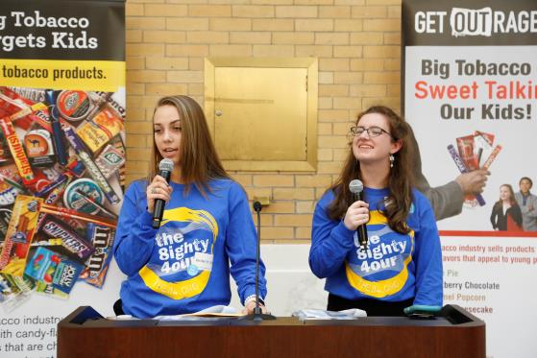
The 84
The 84 is a statewide movement of youth fighting tobacco in MA.
  Formed through local organizations or high schools.
  Youth educate peers and community members about the influence of the tobacco and vaping industries.
  Participate in Kick Butts Day, an annual event at the MA State House.
Notes:
Talking Points:
The 84 is a statewide movement of youth fighting tobacco in Massachusetts.
The 84 represents the 84% of Massachusetts youth who did NOT smoke when the movement began. Now, 92% of youth do NOT smoke.
Youth groups in a high school or community organization who want to fight against Big Tobacco sign up to become an 84 Chapter and be a part of the movement.
What do The 84 Chapters do?
Educate their peers and adults about the tobacco industry’s marketing tactics
Help to create change locally and statewide to reduce the influence of tobacco in their communities
Survey youth and adults about their perception of the prices and availability of other tobacco products
Promote social norms messaging around youth tobacco use
Annually, The 84 Chapters actively engage in important tobacco prevention events.
More information can be found at https://the84.org/ or by talking to your local Tobacco-Free Community Partnership.

Slide 54
Vaping Cessation
The Truth Initiative just launched a first-of-its-kind free e-cigarette quit program now available to young vapers looking for help. The program is tailored by age group to give appropriate recommendations about quitting and also serves as a resource for parents looking to help their children who now vape. It is being launched and integrated into the already successful This is Quitting (app) and BecomeAnEX® digital cessation programs from Truth Initiative.
Teens, adults, and parents of teens seeking help around quitting e-cigarettes/JUULing can text “QUIT” to (202) 804-9884.

Slide 55
Notes:
Smokefreeteen.gov is a resource for teens who want to quit tobacco.

Slide 56
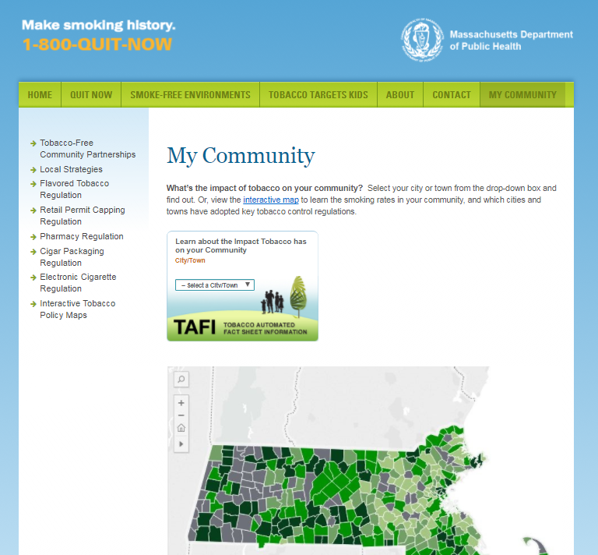
What can you do?
Support town/city tobacco regulations
  Retail Permit Capping Regulation
  Visit “My Community” on
  makesmokinghistory.org
  to learn more
Notes:
Tell your audience that many people think the tobacco problem is solved. It’s not. The youth cigarette smoking rate continues to decrease in Massachusetts, but 2,500 young people still become cigarette smokers every year in our state. Plus, young people’s use of other tobacco products and e-cigarettes has increased dramatically over time.
Strongly encourage your audience to support local strategies and policies:
Restricting sales of flavored tobacco products to adult-only establishments
Minimum cigar pricing
Pharmacy bans
Capping number of tobacco retailers
Include e-cigarettes in the smoke-free workplace law
Frame raising the minimum age of purchase to 21 as an effective part of a comprehensive strategy.
Important: Visit http://makesmokinghistory.org/my-community/ to learn more and support local strategies

Slide 57
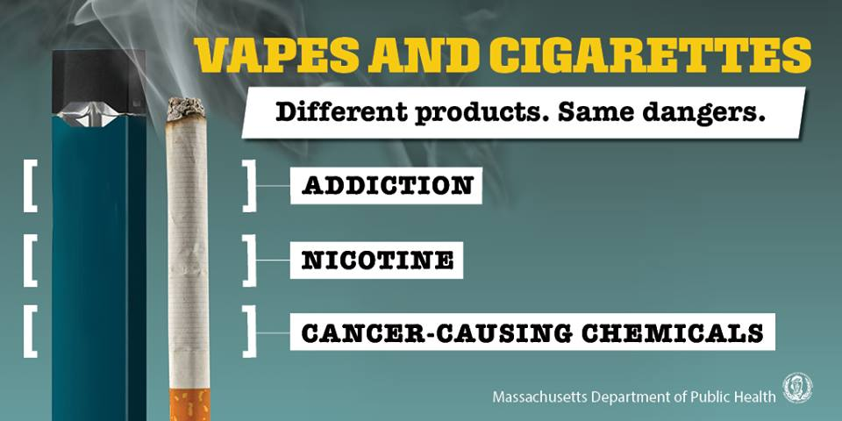
Youth Campaign
Website: www.mass.gov/vaping
Instagram: @GetTheVapeFacts
YouTube (MassDPH): Vapes & Cigarettes. Get the Facts.
Posters, handouts, mirror clings – available through the Massachusetts Clearinghouse
  https://massclearinghouse.ehs.state.ma.us/

Slide 58
Resources
Poster

Slide 59
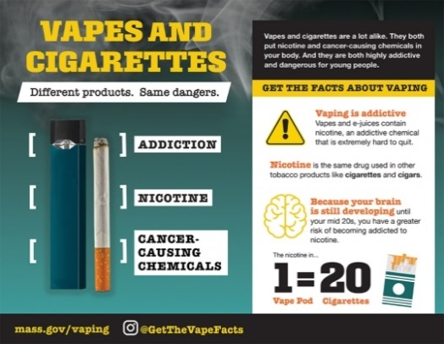
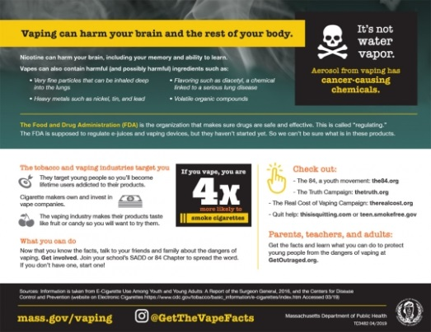
Handout

Slide 60



Mirror Clings

Slide 61
Tobacco Free Mass
Tobacco Free Mass is the statewide tobacco advocacy organization.
Executive Director: Gwen Stewart
Gwendolyn.stewart@cancer.org
Office: 508-270-4652
Cell: 617-500-3449
30 Speen Street, Framingham MA 01701

Slide 62
Contact Information
Tina Grosowsky
Program Coordinator
Central MA Tobacco Free Community Partnership
Email: tina.Grosowsky@umassmed.edu
Phone: 508-856-5067
Website: www.GetOutraged.org

Slide 63
Questions / discussion
Notes:
This is at time for questions/discussion. This section can be moved to a different location in the presentation, if desired. If you do move this section, be sure to adjust the table of contents accordingly.

